Slide 1
Analysing Data Set Using Recommender System
Kadha Ram Kaushik - 20176034
Karthik Reddy - 20176035
Vemula Sudheendra - 20176036
Alfred Vivek - 20176048
Under the Guidance of :
Dr.P.Arun Kumar
(Resource Principal Mentor)
(MSIT - IIITH)

Slide 2


Slide 3
Introduction
The aim of a Recommendation system is to recommend relevant items to a specific user.
This predictions of relevant items to a user is done on analysis of previous data of that particular user.
The analysis of recommender system is done by working on three different algorithms which are content based filtering, collaborative filtering and the hybrid model.

Slide 4
Content Based Filtering
The general idea behind these recommender systems is that if a person liked a particular item, he or she will also like an item that is similar to it.
Content Based Filtering suggest similar items based on a particular item.
This system uses item metadata, such as genre, director, description, actors, etc. for movies, to make these recommendations.
Content-based filtering uses data of the items the user has interacted to recommend similar items. It depends only on the user previous choices.

Slide 5
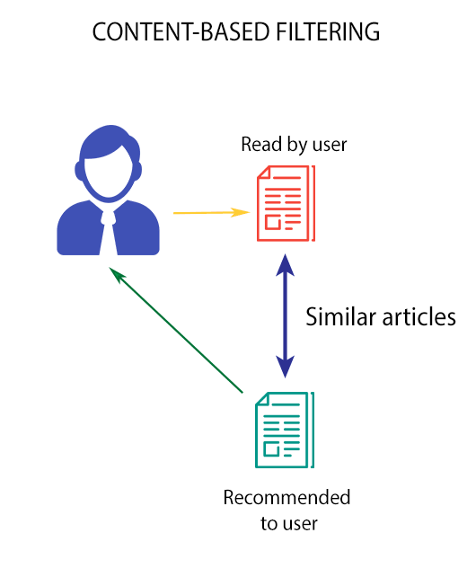

Slide 6
Collaborative filtering
These systems try to predict the rating or preference that a user would give an item-based on past ratings and preferences of other users.
Collaborative filters do not require item metadata like its content-based counterparts.
This method makes automatic predictions about the interests of a user by collecting preferences from many users who are similar to a respective user..

Slide 7

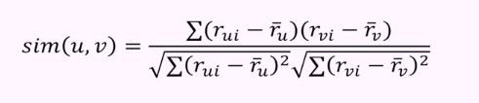
Collaborative filtering
Normalising the level optimism of various user by finding the adjusted mean.
Then the rating for an item is predicted by the following formula:
The simplified form of this Pearson’s correlation looks like this:

Slide 8
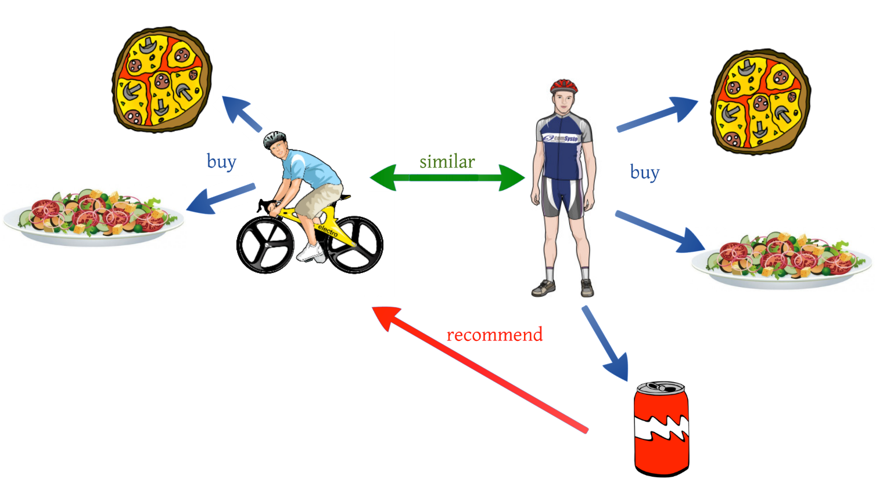
Collaborative Filtering

Slide 9
Hybrid Model
The idea behind hybrid techniques is that a combination of algorithms will provide more accurate and effective recommendations than a single algorithm as the disadvantages of one algorithm can be overcome by another algorithm
Different ways of hybridization are:
Implementing CF and CB separately and combine their predictions.
Incorporating some content based characteristics into collaborative approach.
Incorporating some collaborative characteristics into content based approach.
Constructing a general unifying model that incorporates both content-based and collaborative.

Slide 10
Limitations of Recommender System
Cold start for a new user
Data sparsity
The content based filter has many factors that can affect the actual output.
Scalability
Changing User preferences.

Slide 11
Conclusion
The Several recommendation systems have been proposed that are based on collaborative filtering, content and hybrid recommendation methods but these have some problems which are the challenges for research work.
It is required to work on this research area to explore and provide new methods that can reduce the challenges and provide recommendations more accurately.
Thus, the current recommendation system needs improvement for present and future requirements of better recommendation qualities.

Slide 12
References
Francesco Ricci and Lior Rokach and Bracha Shapira, Introduction to Recommender Systems Handbook, Recommender Systems Handbook, Springer, pp. 1-35.
Xiaoyuan Su, Taghi M. Khoshgoftaar, A survey of collaborative filtering techniques, Advances in Artificial Intelligence archive.
Pasquale Lops, Marco de Gemmis, Giovanni Semeraro, Content-based Recommender Systems: State of the Art and Trends, Recommender Systems Handbook, Springer, Pages 73-105.
Burke, R.: Hybrid web recommender systems. In: The Adaptive Web, Springer Berlin / Heidelberg, Pages. 377–408.

Slide 13
Thank You

